Slide 1
Adapting the A* Search Algorithm for Optimizing Delivery Routes
Enhancing Logistics Efficiency with Real-Time Data
Eric Tyler

Slide 2
Introduction
The logistics industry faces significant challenges in optimizing delivery routes to reduce costs and improve delivery times.
Efficient route optimization can lead to reduced fuel consumption, lower operational costs, and enhanced customer satisfaction.
I explore the adaptation of the A* search algorithm, which is traditionally used in pathfinding and graph traversal, for optimizing delivery routes in logistics.

Slide 3
Project Objective
The goal is to adapt the A* algorithm to optimize delivery routes considering real-time traffic data, delivery windows, and vehicle capacities.
By incorporating these factors, we can aim to enhance the efficiency and reliability of delivery services.
This project aims to demonstrate the feasibility and benefits of this approach in a simplified scenario.

Slide 4
The A* Search Algorithm
The A* search algorithm is a widely-used pathfinding algorithm that finds the shortest path between nodes in a graph.
It uses a heuristic function to estimate the cost of reaching the goal from the current node.
A* combines the strengths of Dijkstra's algorithm and Greedy Best-First-Search, making it efficient and optimal.

Slide 5
Adaptation for Delivery Routes
I modified the A* algorithm to account for delivery windows, vehicle capacities, and real-time traffic data.
Delivery windows ensure that packages are delivered within specified time frames.
Real-time traffic data helps avoid congested routes, further optimizing delivery times.

Slide 6
Code Implementation
The heuristic function uses Euclidean distance to estimate the cost between nodes.
The graph represents delivery locations and routes with weights corresponding to travel times or distances.
The A* algorithm processes nodes, updating costs and paths, considering delivery constraints.

Slide 7
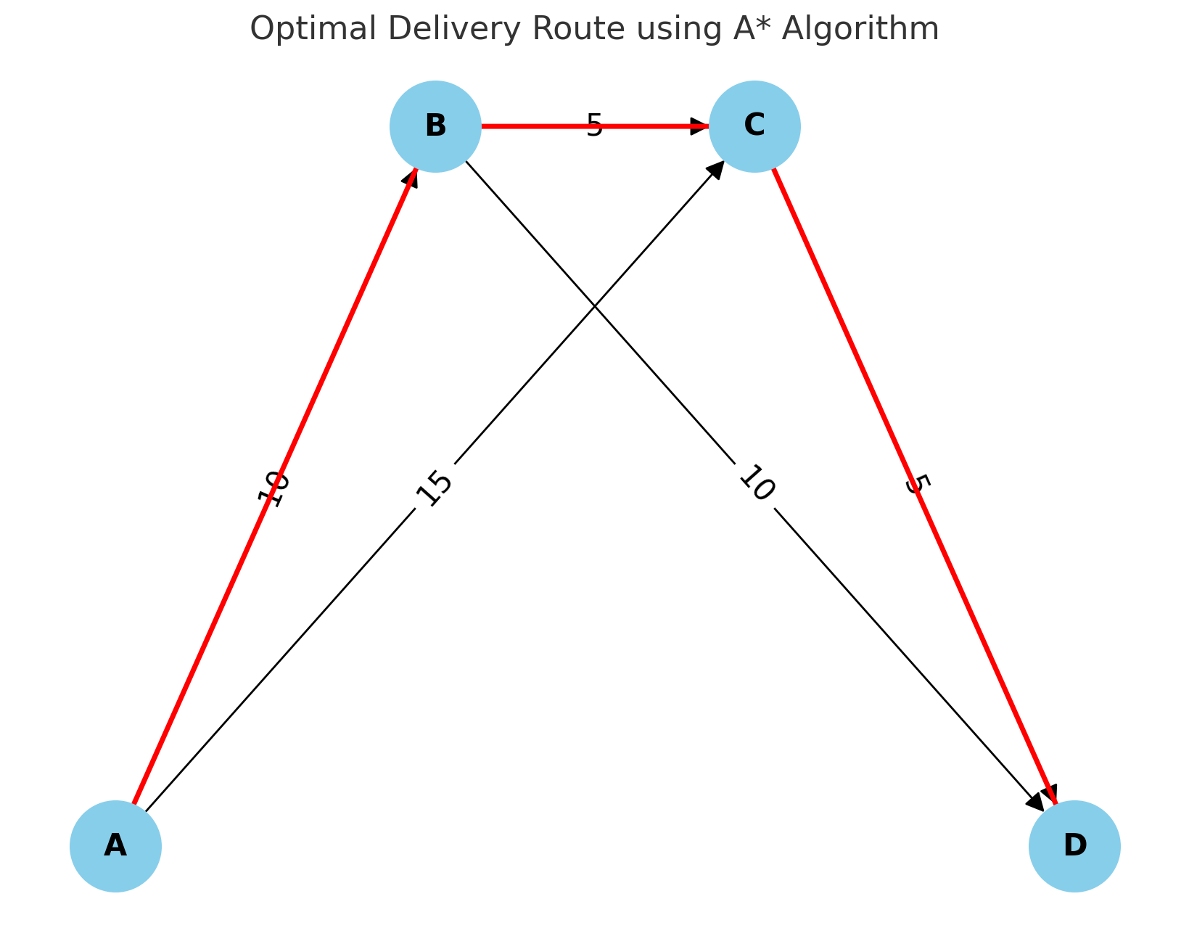
Example Scenario
I demonstrate the adapted A* algorithm with a simplified example graph.
Nodes represent delivery locations, edges represent routes with travel times.
Delivery windows are defined for each node, and the algorithm finds the optimized route.

Slide 8
Benefits and Impact
The adapted A* algorithm can reduce fuel consumption and operational costs by finding efficient delivery routes.
Improved delivery times enhance customer satisfaction and reliability of services.
The approach is scalable and can be applied to various logistics scenarios with real-time data integration.

Slide 9
Conclusion
I presented the adaptation of the A* algorithm for optimizing delivery routes in logistics.
The project demonstrates potential improvements in efficiency and cost-effectiveness.
Future work includes refining the algorithm, incorporating more complex constraints, and testing in real-world scenarios.

